Slide 1

EasyScHED
The best and easiest way to know your work schedule
Computer Application Development - CAD

Slide 2
What is easysched
Manage a Schedule for the Employee and Employer
Employee to view a schedule
Employee to request time off
Manage Employee’s availability
Requesting Holidays or Time Off
Employer get notified of Employee’s Information
Employer can notify Employees of an approval or denial of requests

Slide 3
BDR Software – Who are we??
Computer Application Students – CAD
Understanding and learning many different computer programs
MYSQL
C#
.NET CORE
JAVASCRIP
HTML/CSS
Alongside Advisor: Elham Harirpoush

Slide 4


Preliminary Technical Software
MYSQL
.NET CORE

Slide 5


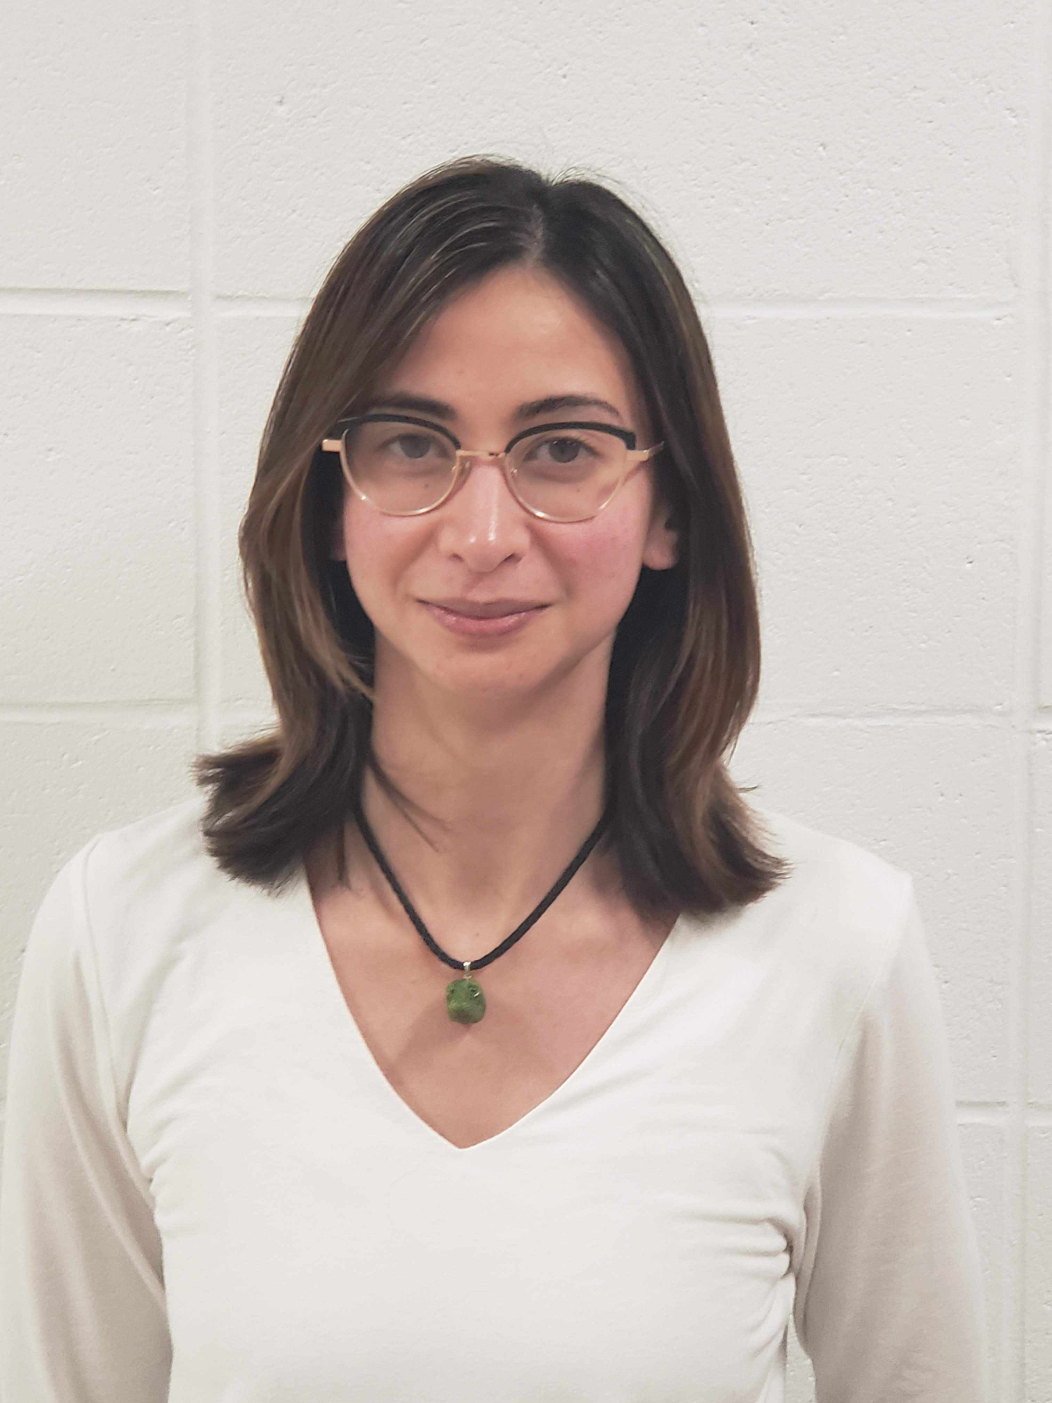
Members of bdr software
Sean Bowry
Jackson Ruby
Kendra Drohan

